Slide 1

Variables, types and packages
Notes:
Title slide variables

Slide 2
Content
Primitive data types
Composite data types
Abstract data types
Type safety and type error
What is a module?
Useful Python modules:
Numpy
Scikit-learn
Matplotlib
Notes:
Content of the presentation:
What is a variable?
Data types
Mutability (constant vs variable)
Scope and visibility
Preallocation

Slide 3

What is a variable
Location where a value is stored
Variable consists of:
Variable name (identifier)
Value
In Python value has the type, not variable
Notes:
Every variable has an associated type (in statically typed languages), a variable name and a value. So in the java example of ‘int a = 5;’, int is the type, a is the variable name and 5 is the value.

Slide 4
What is a variable
Location where a value is stored
Address | Value
000 | NULL
001 | 5
002 | 8
003 | NULL
Variable: a
Notes:
A variable is the location of where a value is stored. So for the computer the variable represent a physical address in the memory, in which the value (that we associate with the variable) is stored.

Slide 5
Scope
Lifetime of a variable
Important for memory allocations
Be aware of scope: prevent unwanted variables!
Notes:
The scope determines the lifetime of a variable; or another way to look at it, were the computer can read the variable. Matlab is an exception and will have its own slide. Scope is important for memory allocations, and it’s good to keep an eye on it.

Slide 6
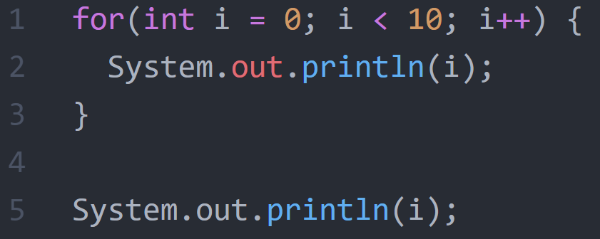
Scope
Output: ?
Output: ?
Notes:
In this Java example, a for-loop is shown where the println displays the value of i. The question is what the output in each case is.
For(int I = 0; I < 10; i++) {
System.out.println(i);
}
System.out.println(i);

Slide 7
Why data types?
Allocation of memory
Define operations possible
Type safety
Notes:
A variable is the location of where a value is stored. So for the computer the variable represent a physical address in the memory, in which the value (that we associate with the variable) is stored.

Slide 8
Python: Strong, dynamical and implicit
Strong:
When you have assigned a type to a value (not the variable!) it will keep that type
E.g. string of numbers will not suddenly become number
Dynamically:
Variables (not values) can change type
Implicit:
Do not declare the type of variables beforehand

Slide 9
Primitive data types in Python
Name | Shorthand | What
Integer | int | Whole numbers
Floating-point number | float | 32-bit number with digits after decimal place
Double precision float | double | 64-bit number with digits after decimal place
Boolean | bool | Value that’s either true or false (0 or 1)
String | str | A list of ASCII characters

Slide 10
Composite data types in Python
Name | Shorthand | What
List | list | Collection of elements of any type
Dictionary | dict | ‘Rows’ of data

Slide 11
Objects: OOP
May contain any of the following:
Variables
Structures
Functions
Object-oriented programming
DIY
Notes:
Matlab: mutable length
Java: length not mutable (same for C, couple of other languages)

Slide 12
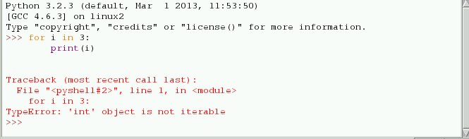
Type safety and type errors
Type safety: prevent type errors
Type casting
Example: integer division
Type error: difference between expected and actual type
Python

Slide 13
Packages
Notes:
Title slide variables

Slide 14
What is a package?
Collection of modules
Module is collection of functions
Notes:
Matlab: mutable length
Java: length not mutable (same for C, couple of other languages)

Slide 15
Installing packages
Through pip: pip install ….
Through conda: conda install …
Check install packages: pip freeze
Update installed package: pip/conda install [package] --upgrade
More advanced: virtual environments

Slide 16
Must-have packages
Numpy
Scikit-learn
Matplotlib
Pandas
Scipy package

Slide 17
Additional packages
Visualization: seaborn, ggplot, bokeh
Computational neuroscience: Brian, NetPyNE
Machine learning: Theano, TensorFlow, Keras, PyTorch

Slide 18
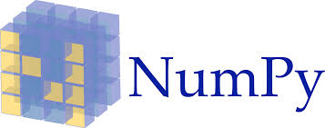
Package: Numpy
Optimized for very fast array calculations
Puts data in objects called numpy arrays
Array has data and type of object
By default only 1 type
Numpy arrays have many built-in functions
E.g. nanmean, nanstd, min, max

Slide 19

Package: Scikit-learn
Extensive machine learning package
Uses numpy under the hood
Easiest way to do simple regressions
NB: use other packages for complicated DNNs

Slide 20

Package: matplotlib
Data visualization
Based on plotting in matlab
Very modular -> easy to customize your plots

Slide 21

Package: Pandas
Specialized for data structures and data analysis
Has numpy and matplotlib built-in

Slide 22
Where to start when looking at package
Look at documentation (e.g. https://numpy.org/devdocs/)
Find a userguide/tutorial
Use help function in iPython/notebook
Look at examples
Let’s look at documentation together
Notes:
Open Numpy devdocs
Show user guide
Go to numpy reference -> mention release
Example: ndarray
Scroll down and click on an attribute
Scroll down and show nanmean/other function
Example: array creation routines

